Slide 1
probability

Slide 2
Probability Rules
Rule of Subtraction
Rule of Multiplication
Rule of Addition

Slide 3
Rule of Subtraction
. The probability that event A will occur is equal to 1 minus the probability that event A will not occur.
P(A) = 1 - P(A')
Occur | Not occur

Slide 4
Rule of Multiplication
Rule of Multiplication The probability that Events A and B both occur
is equal to the probability that Event A occurs
times
the probability that Event B occurs, given that A has occurred.
P(A ∩ B) = P(A) P(B|A)
The rule of multiplication applies to the situation when we want to know the probability of the intersection of two events; that is, we want to know the probability that two events (Event A and Event B) both occur.

Slide 5
Rule of Addition
The rule of addition applies to the following situation. We have two events, and we want to know the probability that either event occurs.
Rule of Addition The probability that Event A or Event B occurs is equal to the
probability that Event A occurs plus the probability that Event B occurs minus the probability that both Events A and B occur.
P(A ∪ B) = P(A) + P(B) - P(A ∩ B)

Slide 6
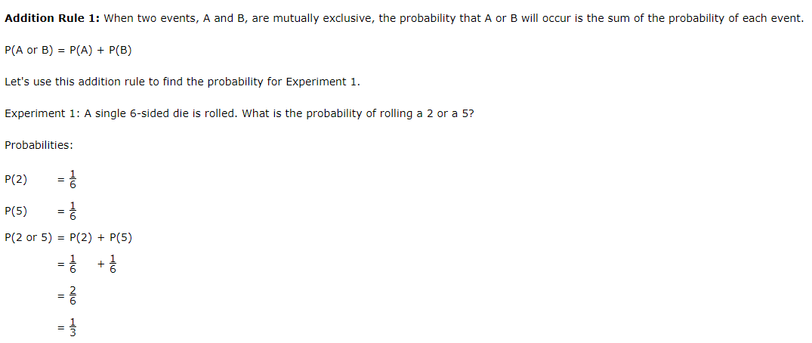
Addition, Mutually exclusive

Slide 7
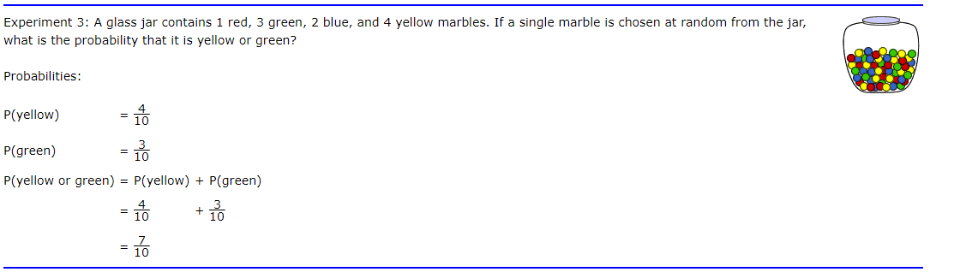

Slide 8
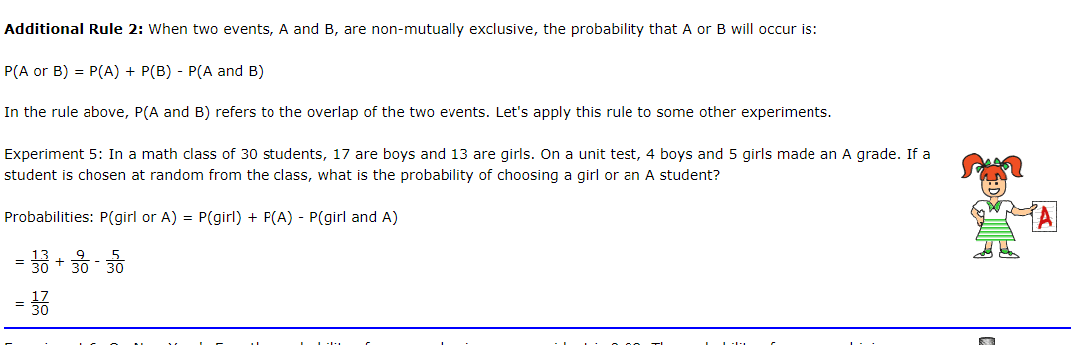

Slide 9
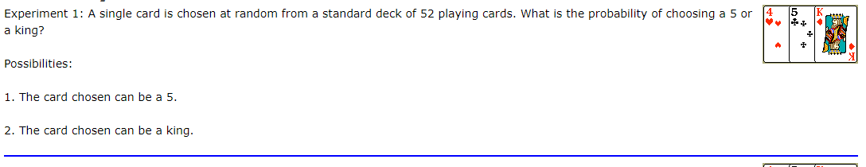
Mutually Exclusive Events
In Experiment 1, the card chosen can be a five or a king, but not both at the same time.

Slide 10
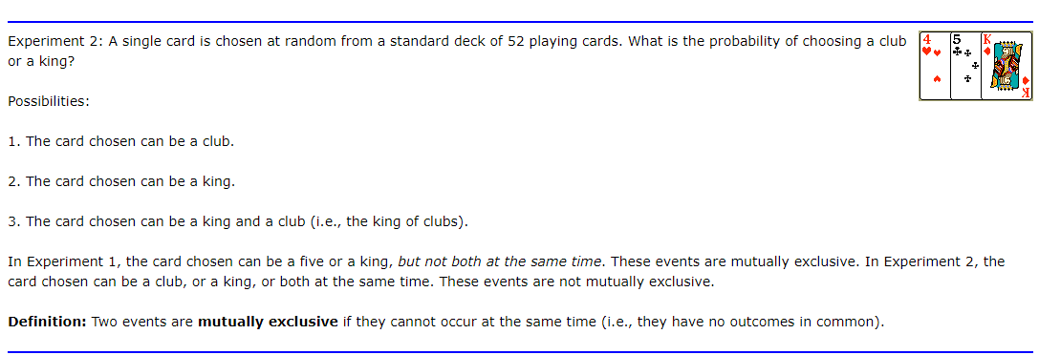
not mutually exclusive

Slide 11
Conditional Probability
Problem: A math teacher gave her class two tests. 25% of the class passed both tests and 42% of the class passed the first test. What percent of those who passed the first test also passed the second test?
Analysis: This problem describes a conditional probability since it asks us to find the probability that the second test was passed given that the first test was passed.

Slide 12


Conditional Probability ..
Multiplication Rule 2: When two events, A and B, are dependent, the probability of both occurring is:

Slide 13
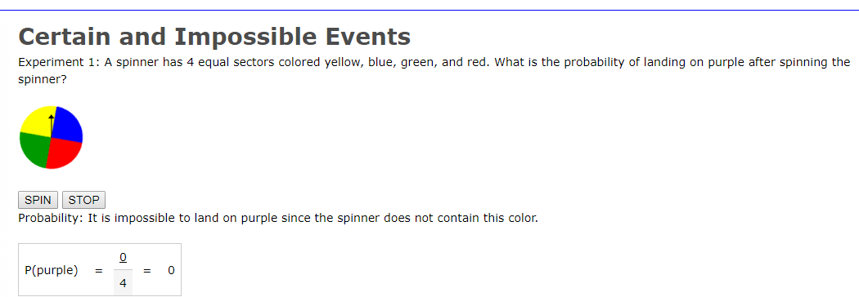
Purple ?

Slide 14
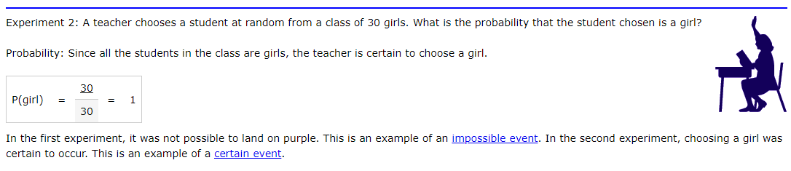

Slide 15
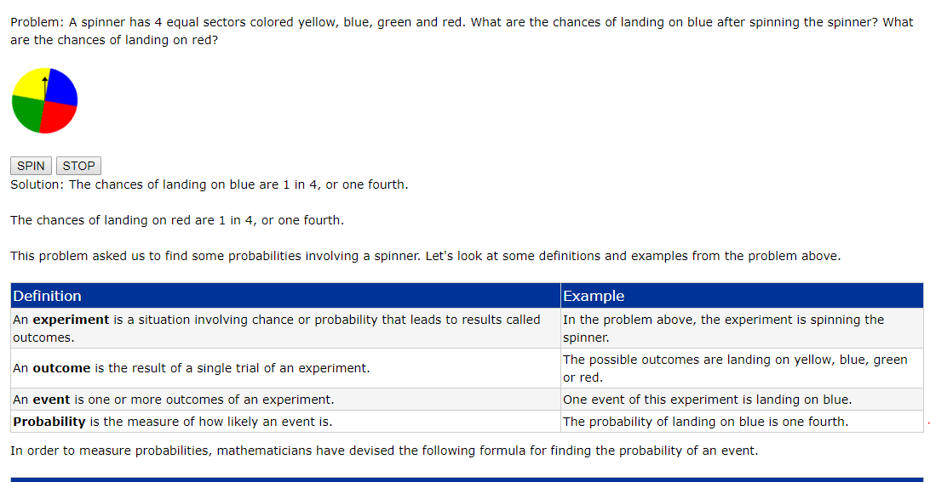

Slide 16
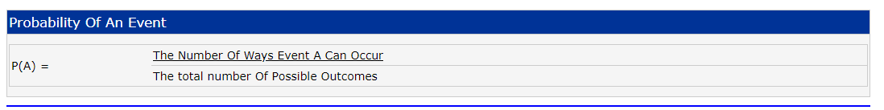

Slide 17
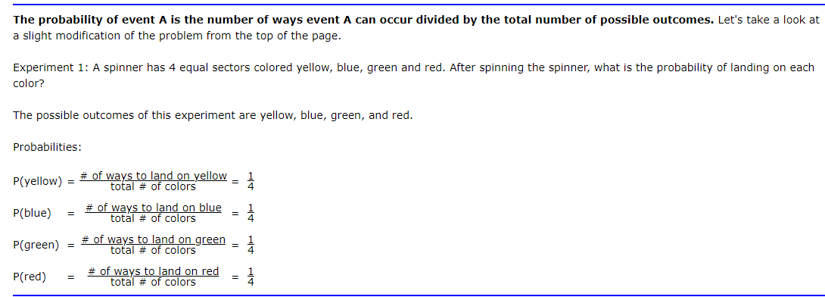

Slide 18
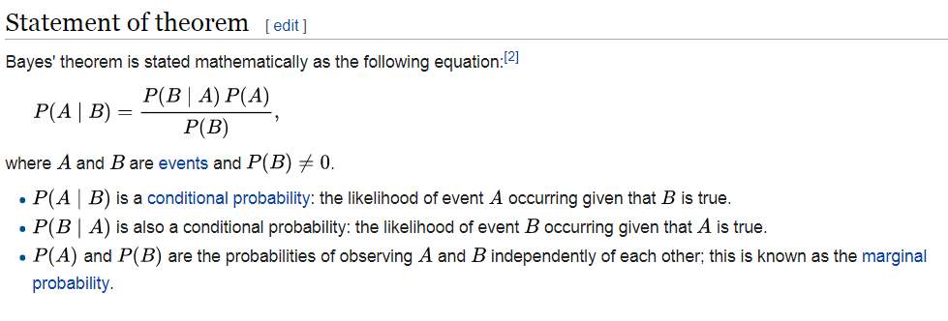
Bayes’ theorem

Slide 19
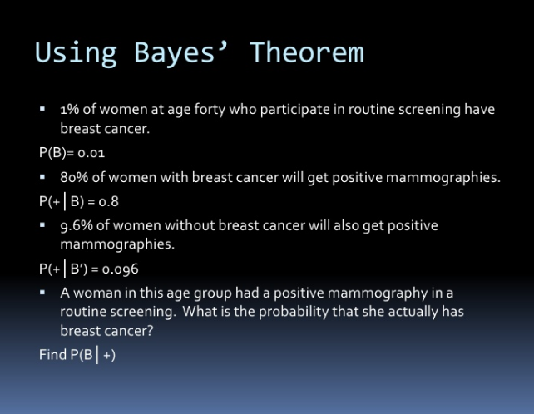

Slide 20
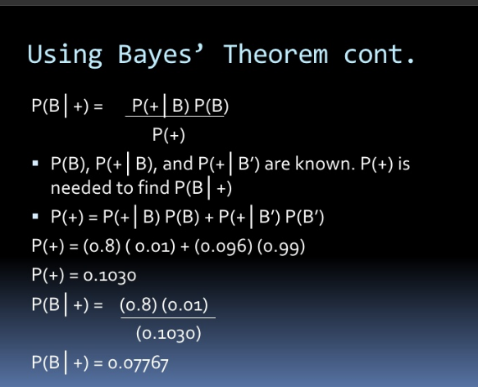

Slide 21
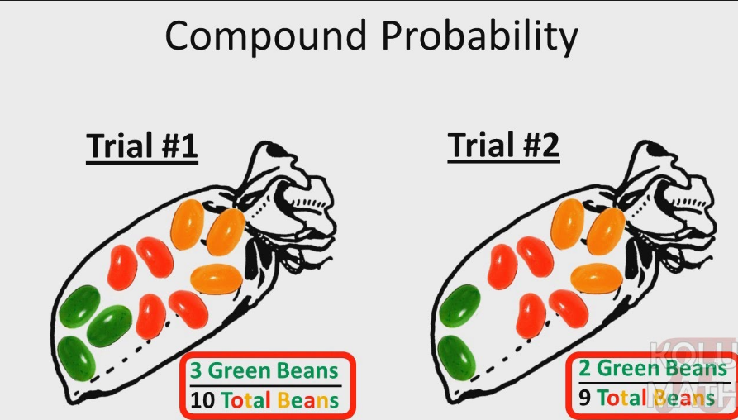
Compound probability

Slide 22
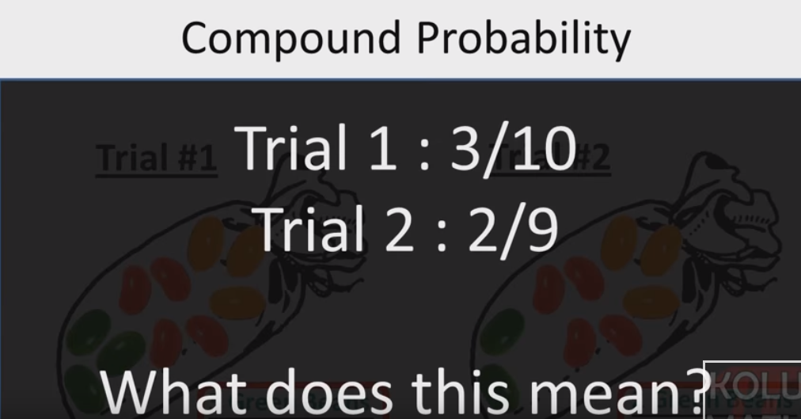

Slide 23
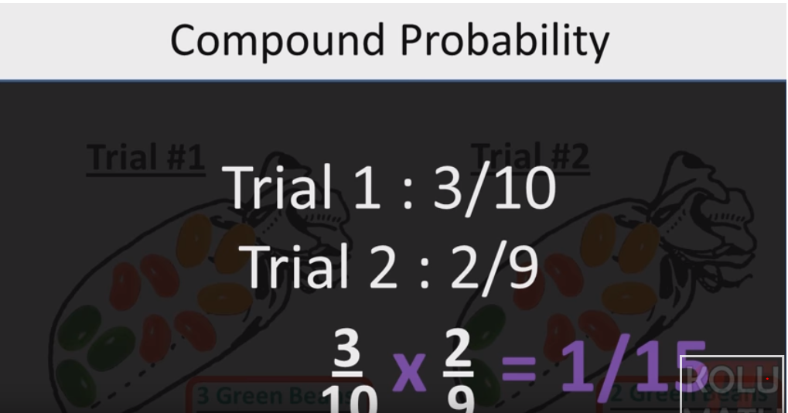

Slide 24
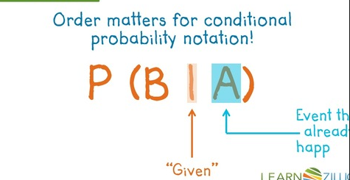

Slide 25
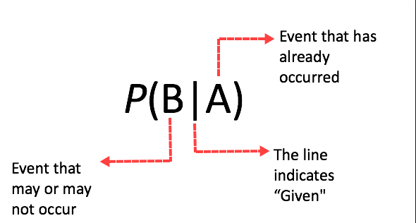

Slide 26
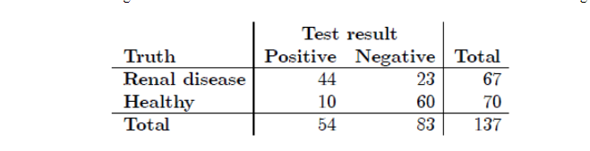
Conditional P

Slide 27
Two events are mutually exclusive or disjoint if they cannot occur at the same time.
The probability that Event A occurs, given that Event B has occurred, is called a conditional probability. The conditional probability of Event A, given Event B, is denoted by the symbol P(A|B).
The complement of an event is the event not occurring. The probability that Event A will not occur is denoted by P(A').
The probability that Events A and B both occur is the probability of the intersection of A and B. The probability of the intersection of Events A and B is denoted by P(A ∩ B). If Events A and B are mutually exclusive, P(A ∩ B) = 0.
The probability that Events A or B occur is the probability of the union of A and B. The probability of the union of Events A and B is denoted by P(A ∪ B) .
If the occurrence of Event A changes the probability of Event B, then Events A and B are dependent.
On the other hand, if the occurrence of Event A does not change the probability of Event B, then Events A and B are independent.

